Slide 1

Building Plugin Architectures in DotNet

Slide 2
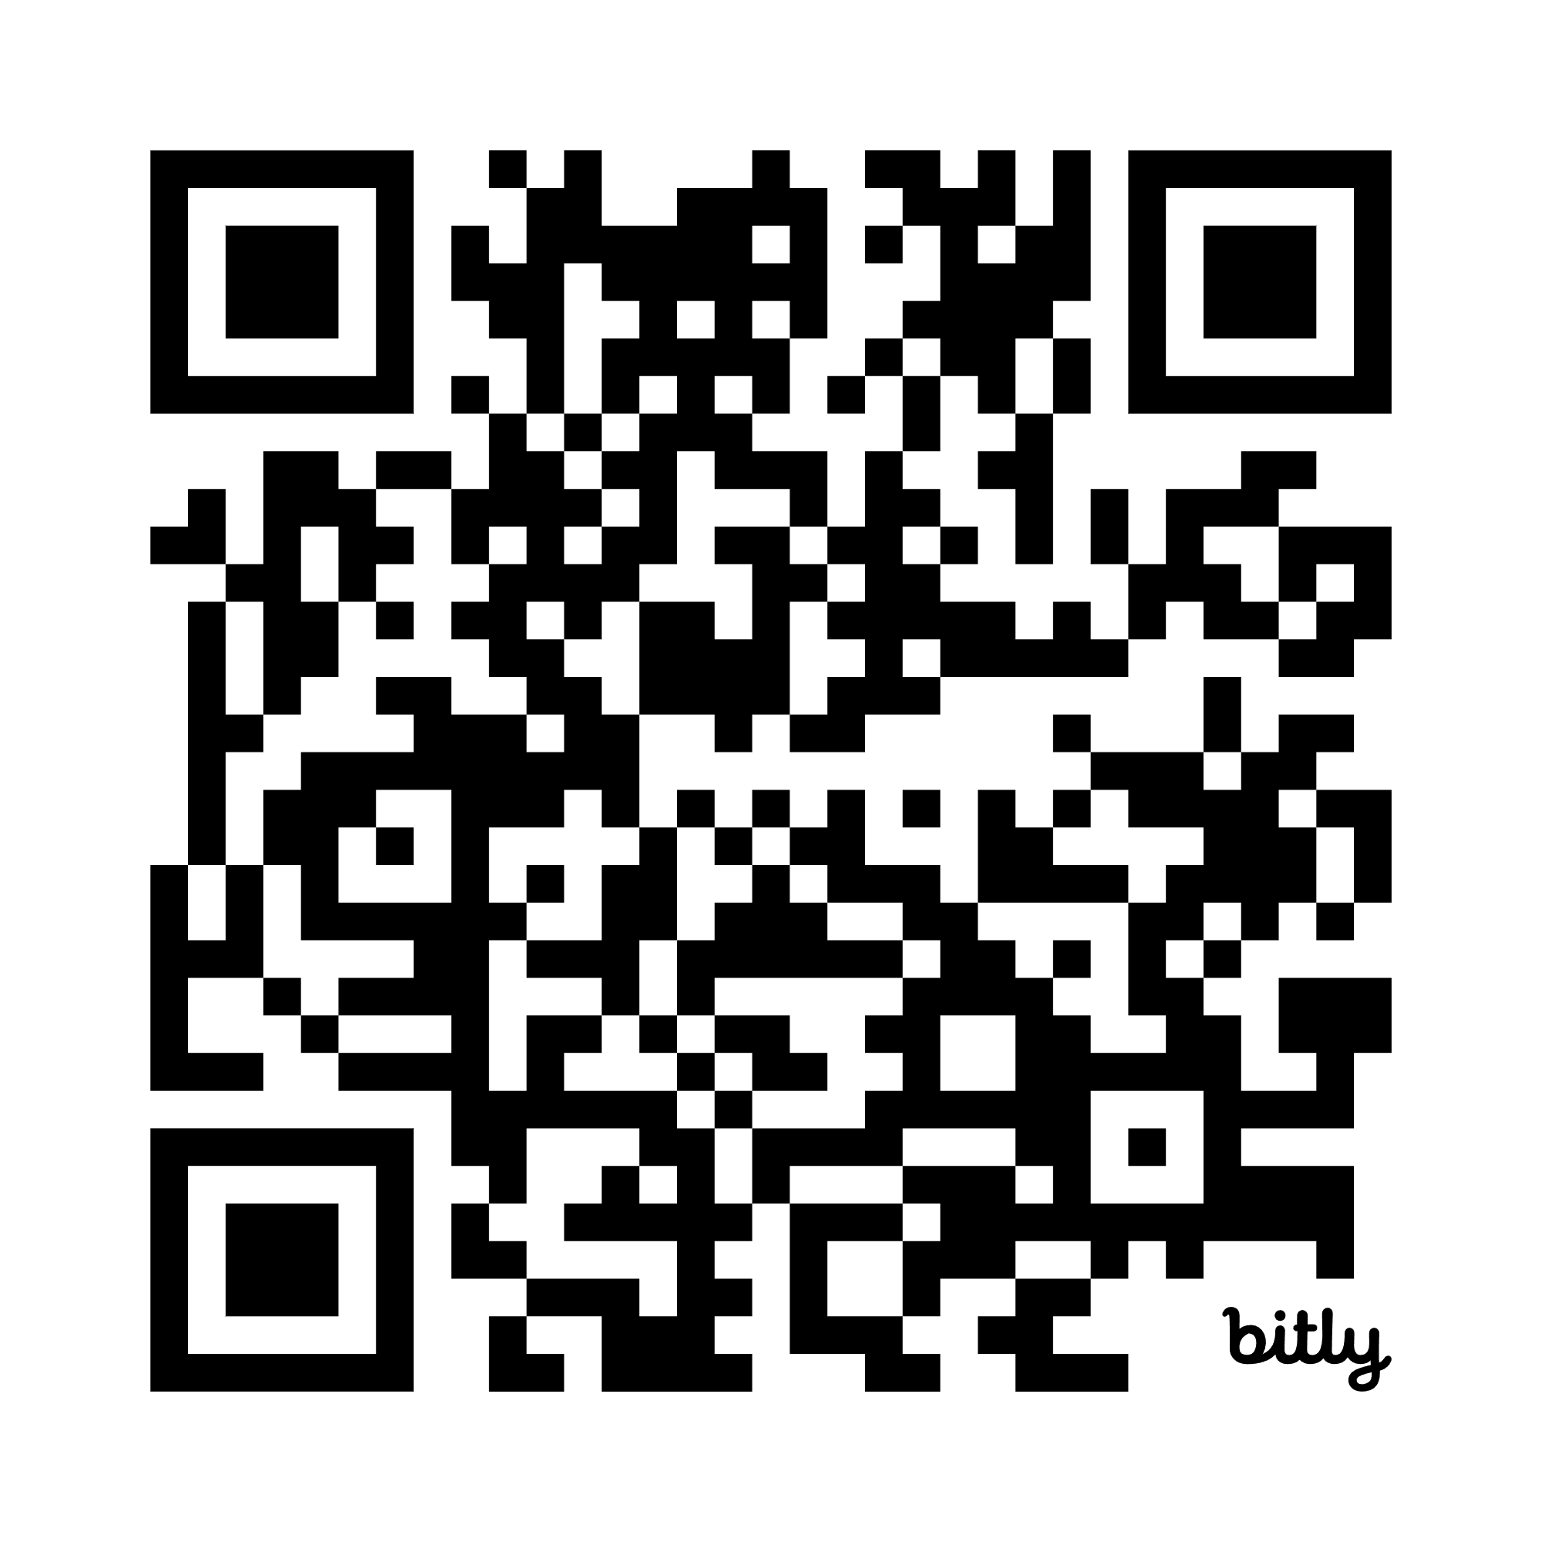
Overview
Who I am and what I do
Pillars of Plugin Architecture
Components & Structure
Scanning & Registration
Kernel Plugins
Feature Plugins
… and more! (we won’t have time)

Slide 3
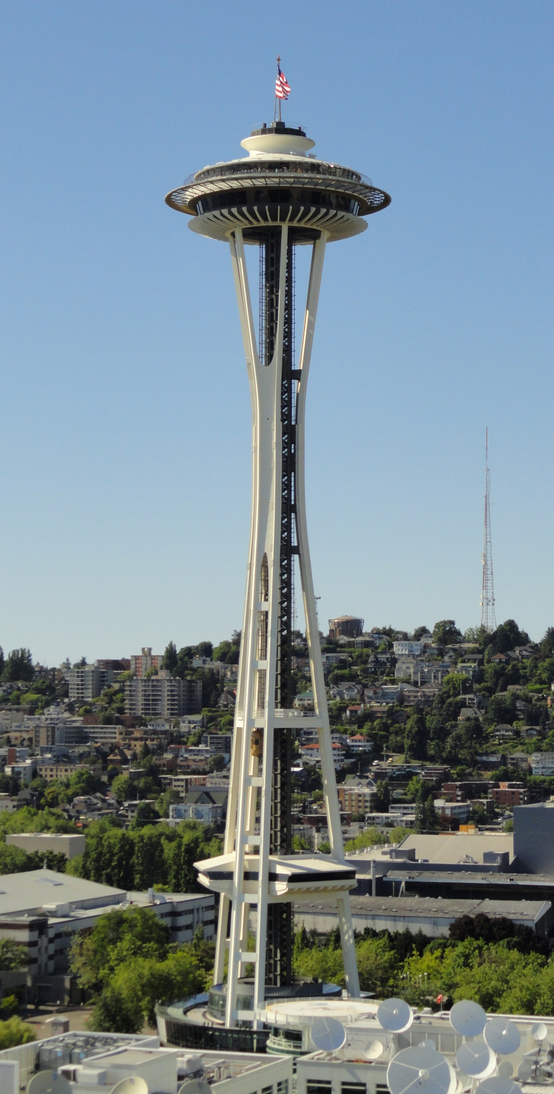
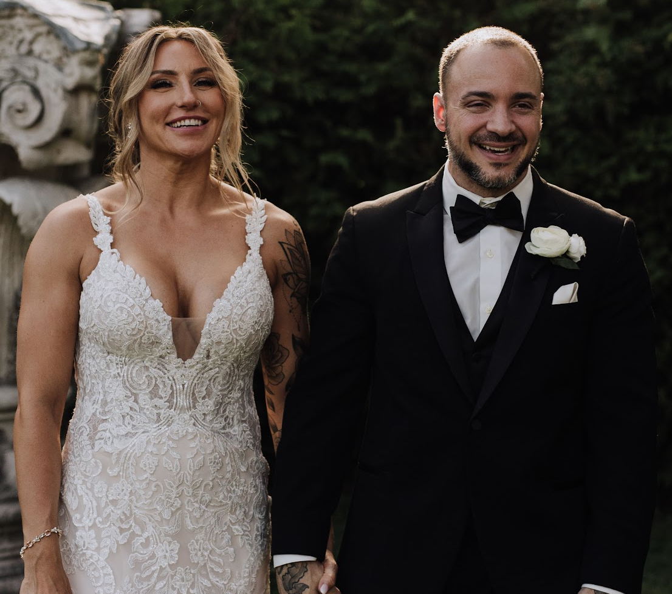
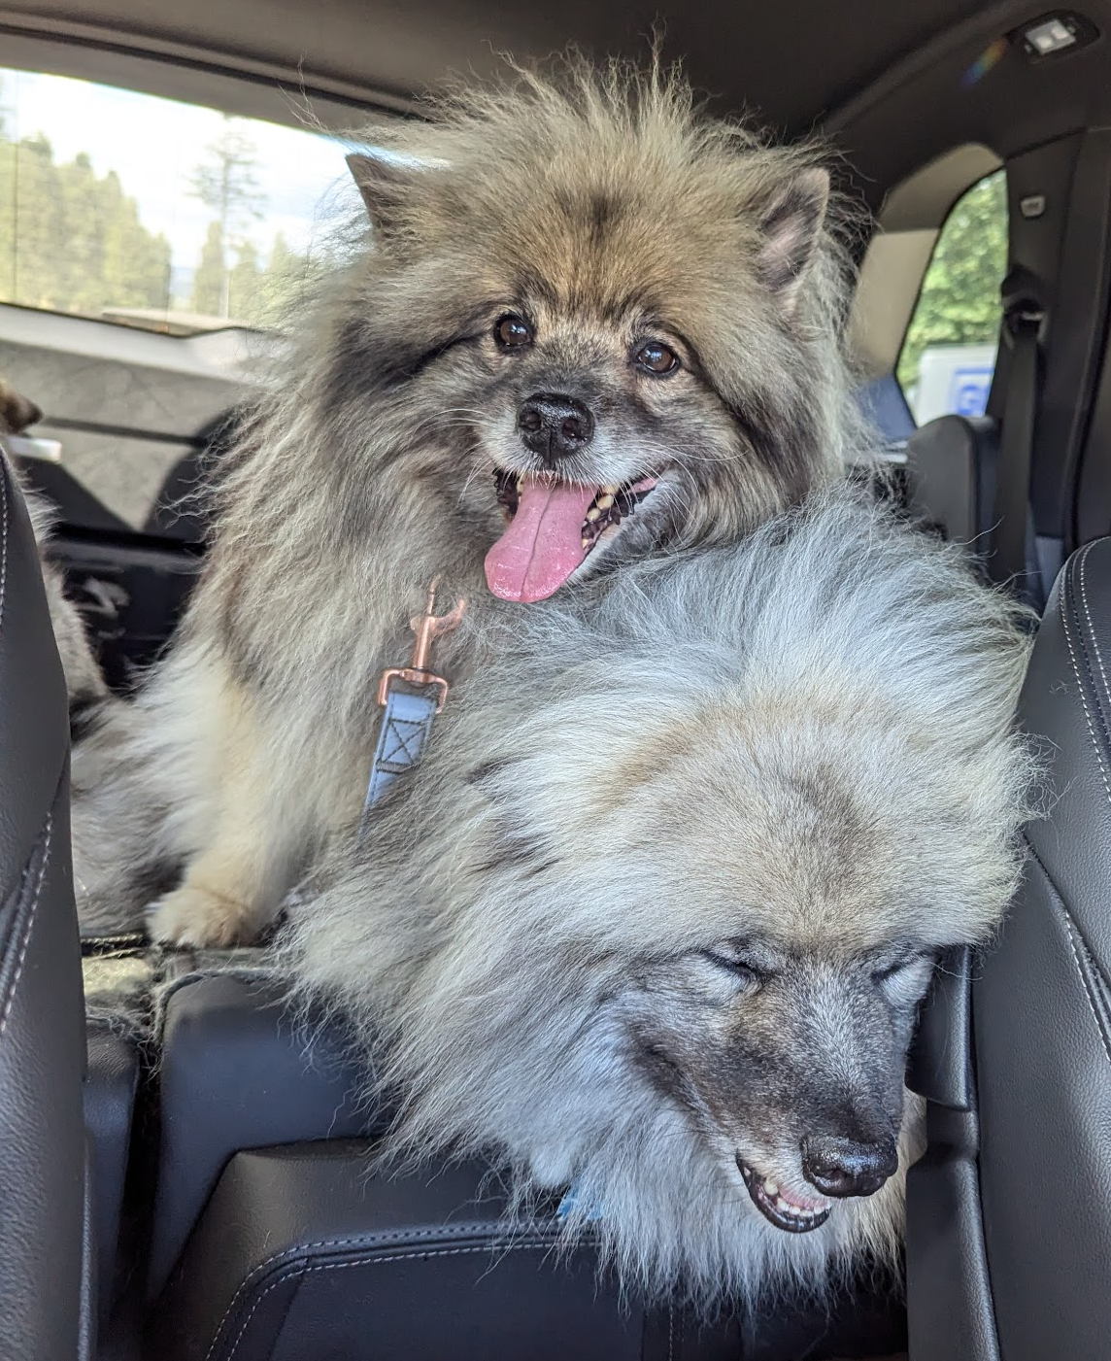




Hi, I’m Nick Cosentino!

Slide 4
Pillars of Plugin Architecture
These are *my* focal points for plugin architecture
Modularity / Isolation
Extensibility / Flexibility
Reusability
Testability

Slide 5
Components & Structure
Entry Point
Business Logic
“Kernel” Plugins
Core functionality you inject into your app
Logging, Telemetry, Auth, Caching, etc…
Inject the implementation into your app (ideally) without touching anything but your configuration
“Feature” Plugins
Extend your application with more functionality
Interact via the SDK.
IPlugin interface (provided BY plugin)
ISomeAPI your plugins can call (provided TO plugin)
… But how does this all come together?!
Kernel
Plugin
Kernel
Plugin
SDK
Feature
Plugin
Feature
Plugin
Kernel
Plugin
Kernel
Plugin
Feature
Plugin
Feature
Plugin
Entry Point:
Console, WPF, ASP.NET Core, etc…
Thin, lightweight, config & go!
Business Logic:
Freedom for mixing in other architectural patterns here!
SDK:
The interface your plugins meet
How they call and are called

Slide 6
DEPENDENCY INJECTION!!!!!!!

Slide 7
Dependency Injection
Use your favorite:
IServiceCollection/Provider
Scrutor
Autofac
Etc…
Use “Assembly Scanning”
For each DLL
Pull out the types you want
Wire them up!
Food for thought:
I will be talking about this from the perspective of “at startup”… but what do you need to consider to do this later in the app lifecycle?

Slide 8
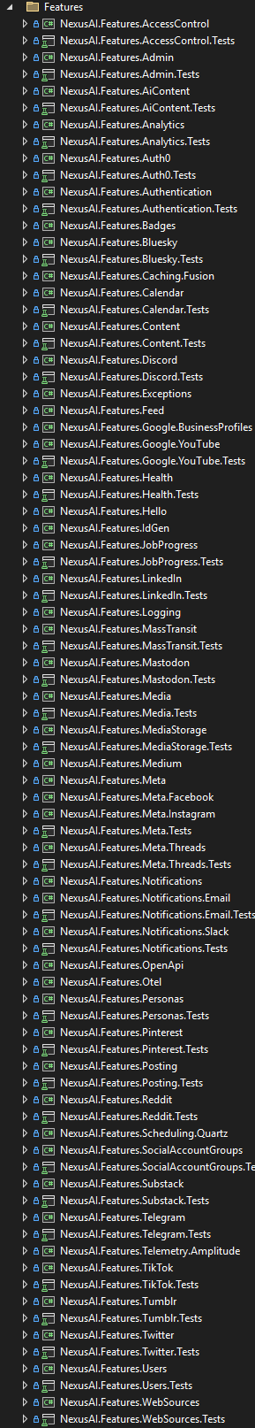
This is a real example!
Kernel
Feature
Kernel
This is made basically impossible to read on purpose.
There are a LOT of plugins
There is a LOT of functionality
Each one is isolated. Project is a boundary.
Features use the SDK. Kernel uses common APIs.
… But how do we hook it all up?!
Feature
Kernel
Feature
Kernel
Feature
Kernel
Feature
Kernel
Feature
Kernel
… there are a lot. You get the idea.

Slide 9
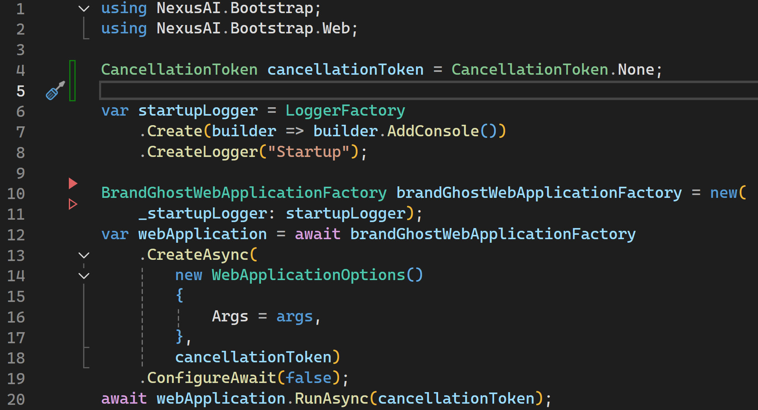
Just 20 lines of code! … But what does it actually do?

Slide 10
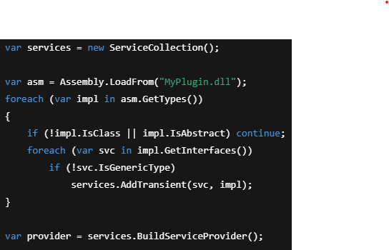
Scan & Register
Typically done with Reflection & DI
Pseudo code:
Foreach assembly file in the target folder(s)
Ask the assembly for every type (that you care about)
Invoke something on the type (give it your DI container) OR Register the type on your DI container
Build the service collection -> IServiceProvider

Slide 11

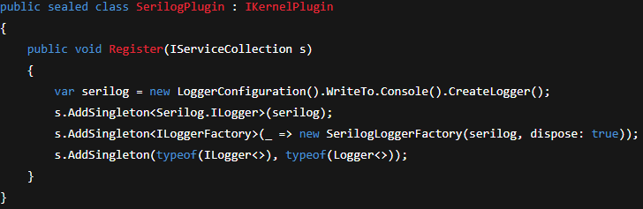
Kernel Plugins
“What if we wanted to swap to X later?”
Generally added into the DI container and meets an interface like…
ILogger, IHybridCache, ITelemetry, etc…
Normally extension methods get used: services.AddLogging(); but…

Slide 12
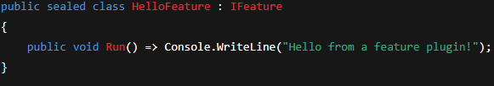
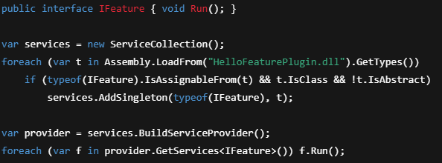
Feature Plugin (Provides IPluginInterface)
Features enable new functionality in the application itself
They extend it, where kernel mode plugins are more like a core implementation
I don’t really believe in “rules”, so this is mostly guidance

Slide 13
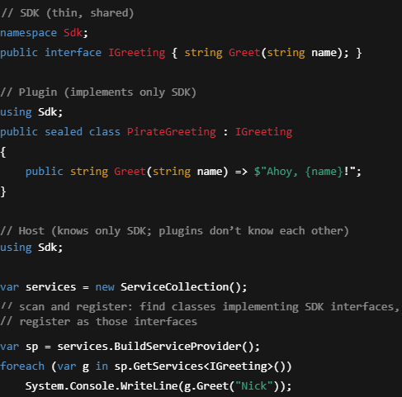
SDK Considerations
Think of the SDK as interface between:
Your core app and plugins
Plugins and your app’s features
It’s shared
Core app shouldn’t know about specific plugins, but it does see the SDK interface
Plugins may need to communicate the other direction… Use the SDK!

Slide 14
Testing
Plugins are, by definition, modular and isolated
New feature plugins shouldn’t touch other code (regressions unlikely)
Can test feature plugins relatively easily in isolation
Kernel plugins usually inject an implementation… How to test?
This may have an impact ACROSS other plugins and the core app
Things become SO modular that our codebase becomes units…
We need alternative coverage!
... Everything might work on its own, but your app doesn’t have the functionality you expect if all of the plugins you need aren’t present!

Slide 15
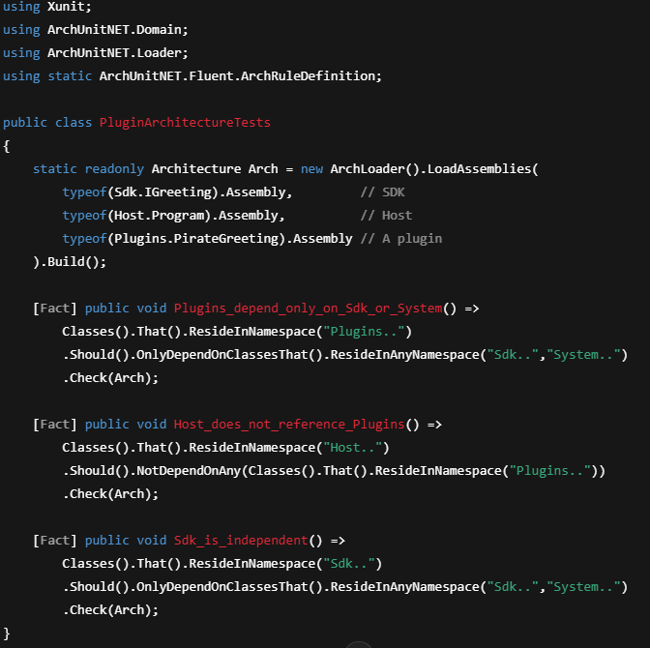
ArchUnitNET

Slide 16
Speed Round Topics For Homework
Façade Design Pattern
Reflection vs Code Generation
Unloading Plugins
Versioning Plugins
Scrutor (Assembly Scanning)
Autofac (Plugin Organization)
Needlr (Mine! Scrutor+Autofac style)
Architecture Testing
Configuration Testing
Building & Deploying w/ Plugins
Security & Privilege
Boundaries

Slide 17
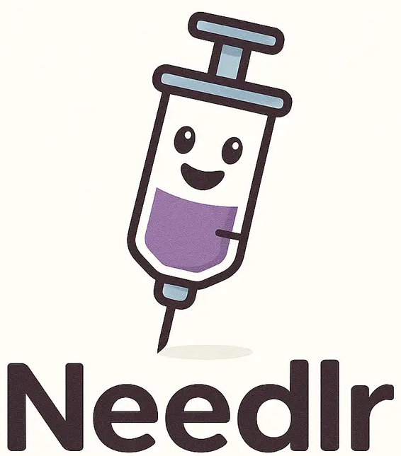
Needlr
I build a fun little dependency scanning and registration library!
https://github.com/ncosentino/needlr

Slide 18
Questions?
AMA – I will make a YouTube video tutorial dedicated to it!

Slide 19
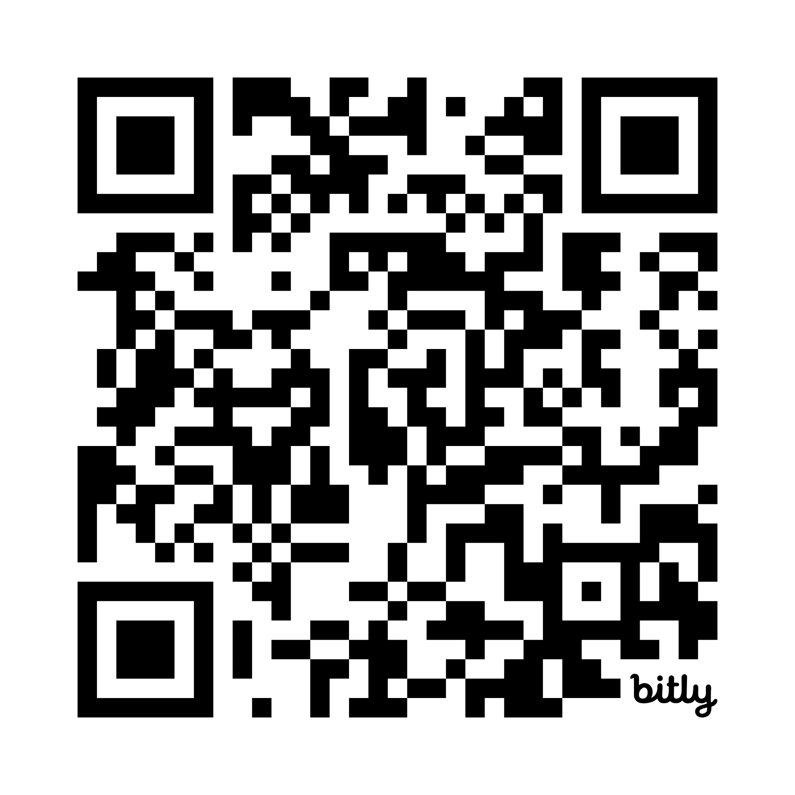
Have Fun Building With Plugins!
You can find me everywhere as: Dev Leader
If you want C# courses, I have them on Dometrain – but all of my other educational content is free!

